Slide 1
Advances of AI in Fusion
Dec 10, 2025
E. Kolemen
Notes:
Note new presentation templates can be found here: https://pppl-intranet.princeton.edu/resources/communications/pppl-logo-files-and-templates

Slide 2
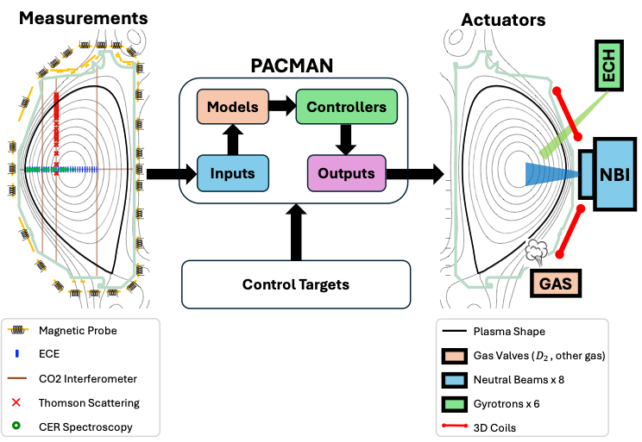
PACMAN: An integrated framework for advanced AI-based control experiments
The Prediction And Control using MachiNe learning (PACMAN) framework brings together real-time diagnostics and real-time actuators into one category within DIII-D control system.
It will serve as the core platform for the future AI-based integrated multi-actuator multi-instability control system (NOFO project)
Rothstein et al 2025 arXiv:2511.08818

Slide 3
AI Control for Fusion:
Demonstrating FPP solutions on DIII-D [NOFO project]
Motivation
We have demonstrated AI controllers for individual instabilities mostly using single actuators.
The next step is to build an integrated, multi-actuator control system capable of managing multiple instabilities simultaneously, a requirement for ITER and future FPPs.
Main components
Feedforward scenario design with an interactive LLM
Multi-Actuator Control for precise deposition & profile control
Robust monitoring: Diagnostic Failure Resilience
Real-time, failure-resilient profile reconstruction
PACMAN as the platform for integrated AI control

Slide 4
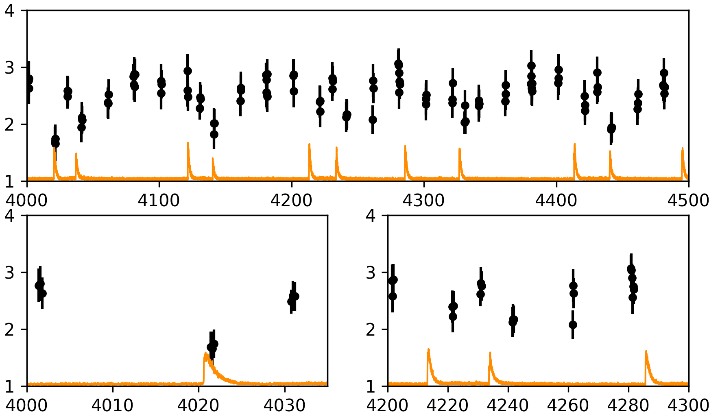
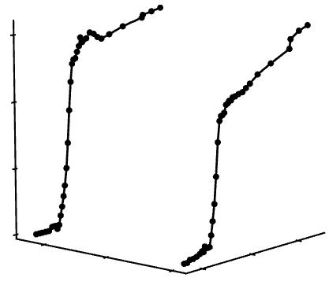
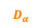
Seeing Through the Gaps: AI for Super-Resolution and Diagnostic Recovery in Fusion Devices
In extreme environments diagnostics can fail, degrade, or miss critical events due to limited resolution.
Edge Localized Modes (ELMs) happen in milliseconds, and Thomson Scattering (TS) is usually too slow to capture their full dynamics.
Several ELM cycles of DIII-D discharge #153671 near the edge (Z = 0.71m)
One ELM cycle at time t=3796ms of
DIII-D discharge #174823
Measured TS
6
4
Measured TS
ELM captured by TS
ELMs missed by TS
2
0
0.4
3792
3796
0.6
3800
0.8
Time (ms)
Location (m)
Time (ms)
Time (ms)
Jalalvand et al., Nat Comm 16, 8506 (2025)

Slide 5
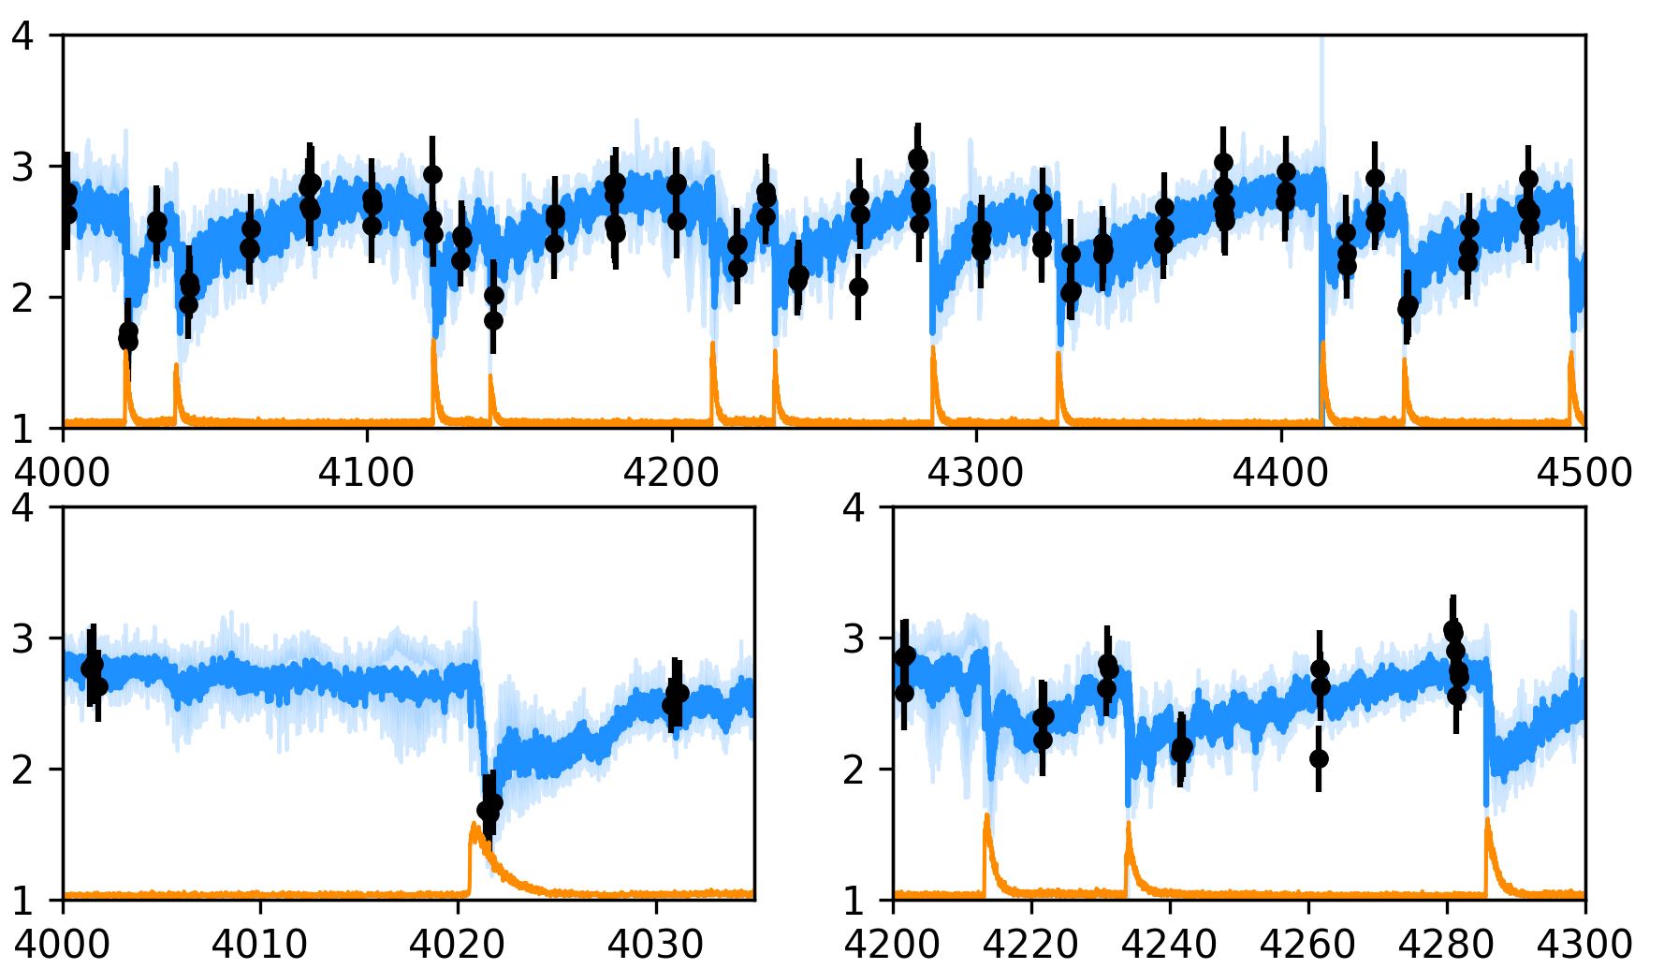
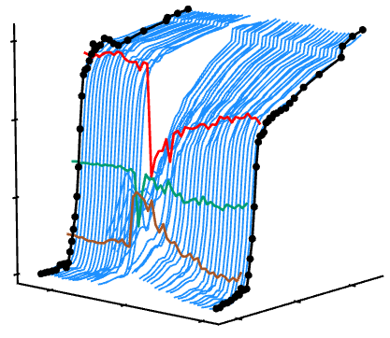
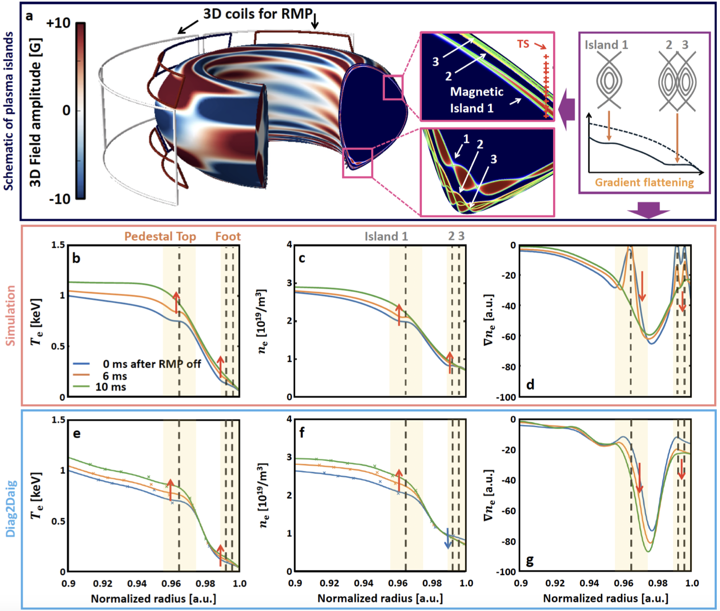
Seeing Through the Gaps: AI for Super-Resolution and Diagnostic Recovery in Fusion Devices
In extreme environments diagnostics can fail, degrade, or miss critical events due to limited resolution.
Edge Localized Modes (ELMs) happen in milliseconds, and Thomson Scattering (TS) is usually too slow to capture their full dynamics.
AI model, so-called Diag2Diag, leverages correlations among multiple sensors, recreating synthetic super-resolution TS (SRTS) in MHz.
Enabling observation of a complete ELM cycle experimentally.
Revealing hidden physics: The AI uncovered experimental evidence that magnetic islands flatten plasma edges under external fields, confirming a long-standing ELM suppression theory.
Several ELM cycles of DIII-D discharge #153671 near the edge (Z = 0.71m)
One ELM cycle at time t=3796ms of
DIII-D discharge #174823
SRTS
Measured TS
SRTS
6
Measured TS
4
Measured TS
ELM captured by TS and SRTS
ELMs missed by TS
Captured by SRTS
2
0
0.4
3792
3796
0.6
3800
0.8
Time (ms)
Location (m)
Time (ms)
Time (ms)
Jalalvand et al., Nat Comm 16, 8506 (2025)

Slide 6
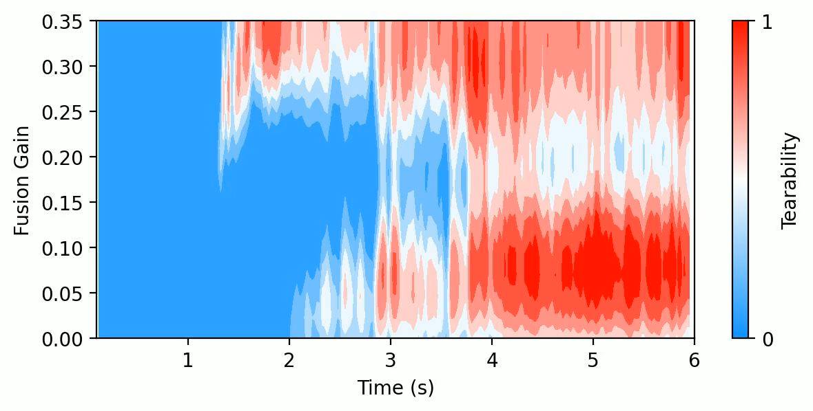
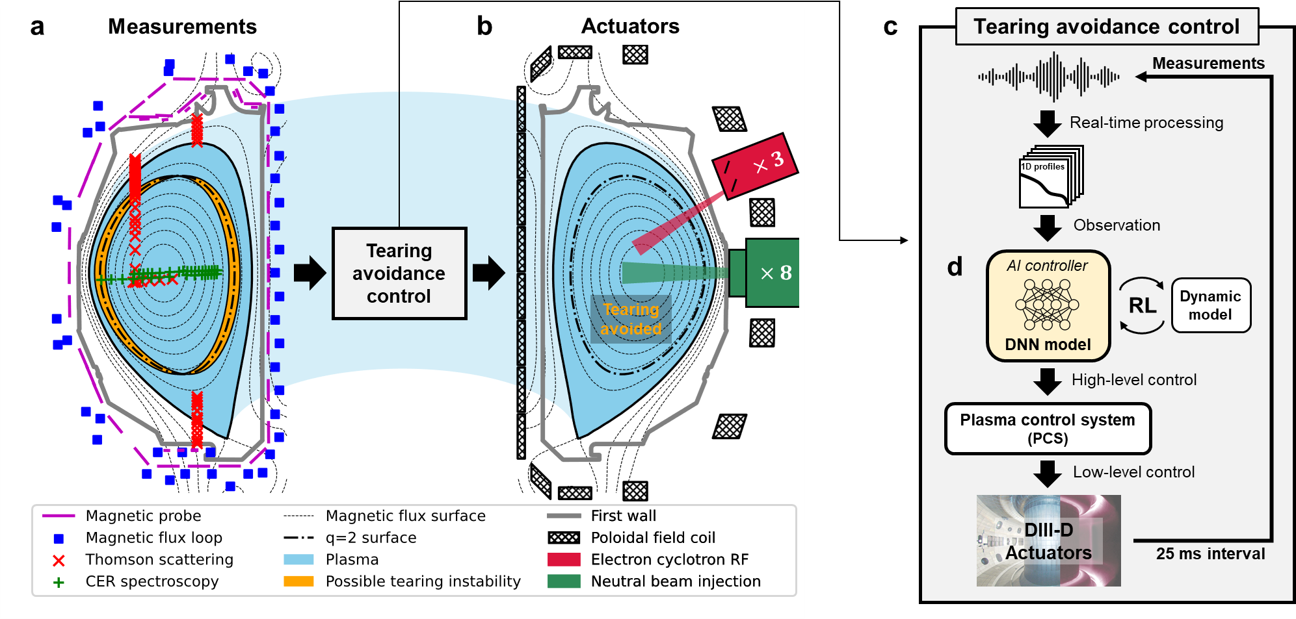
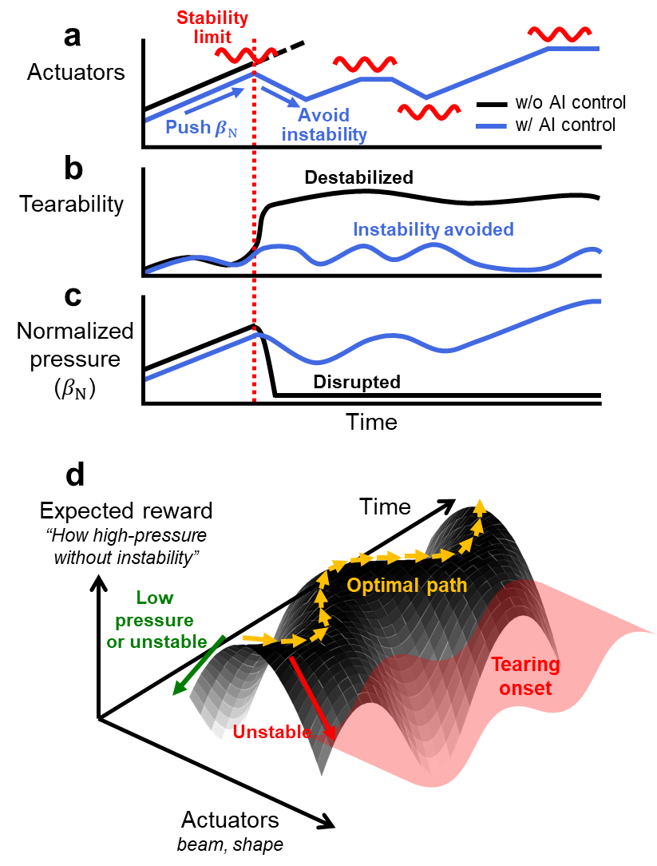
Avoiding tearing mode instabilities with RL at DIII-D
RL-controller tries to avoid TM while keeping the gain as high as possible
Design AI control: Objective is to avoid instability while pushing up performance.
Preemptive control of beam power and plasma shape can avoid the onset of tearing modes.
(Concept of tearing avoidance)
(Implementation in DIII-D PCS)
Seo et al., Nature 626, 746–751 (2024)

Slide 7
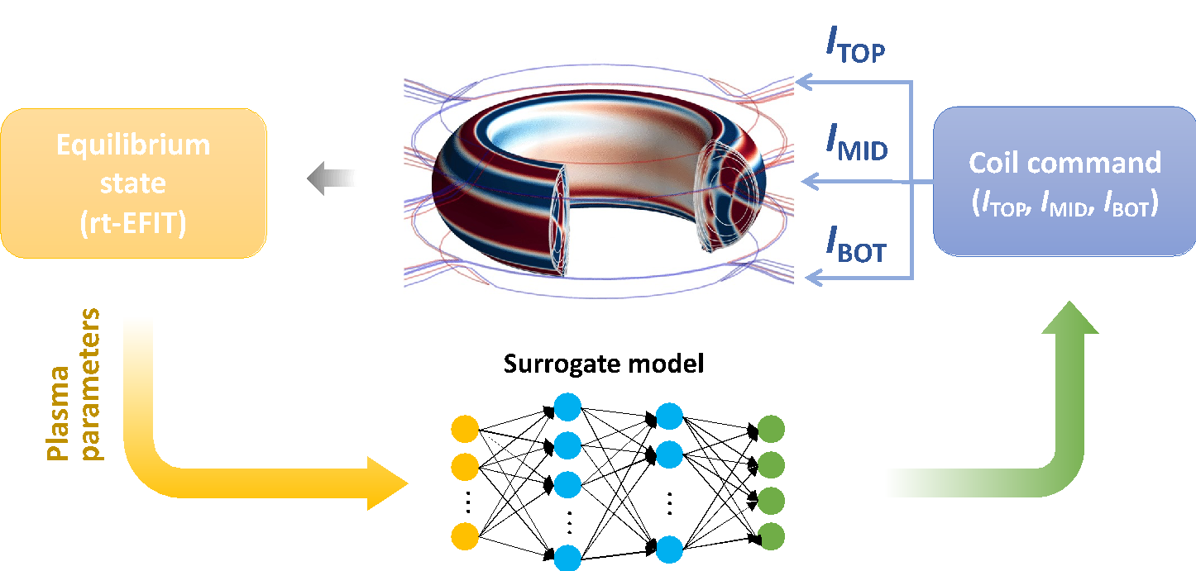
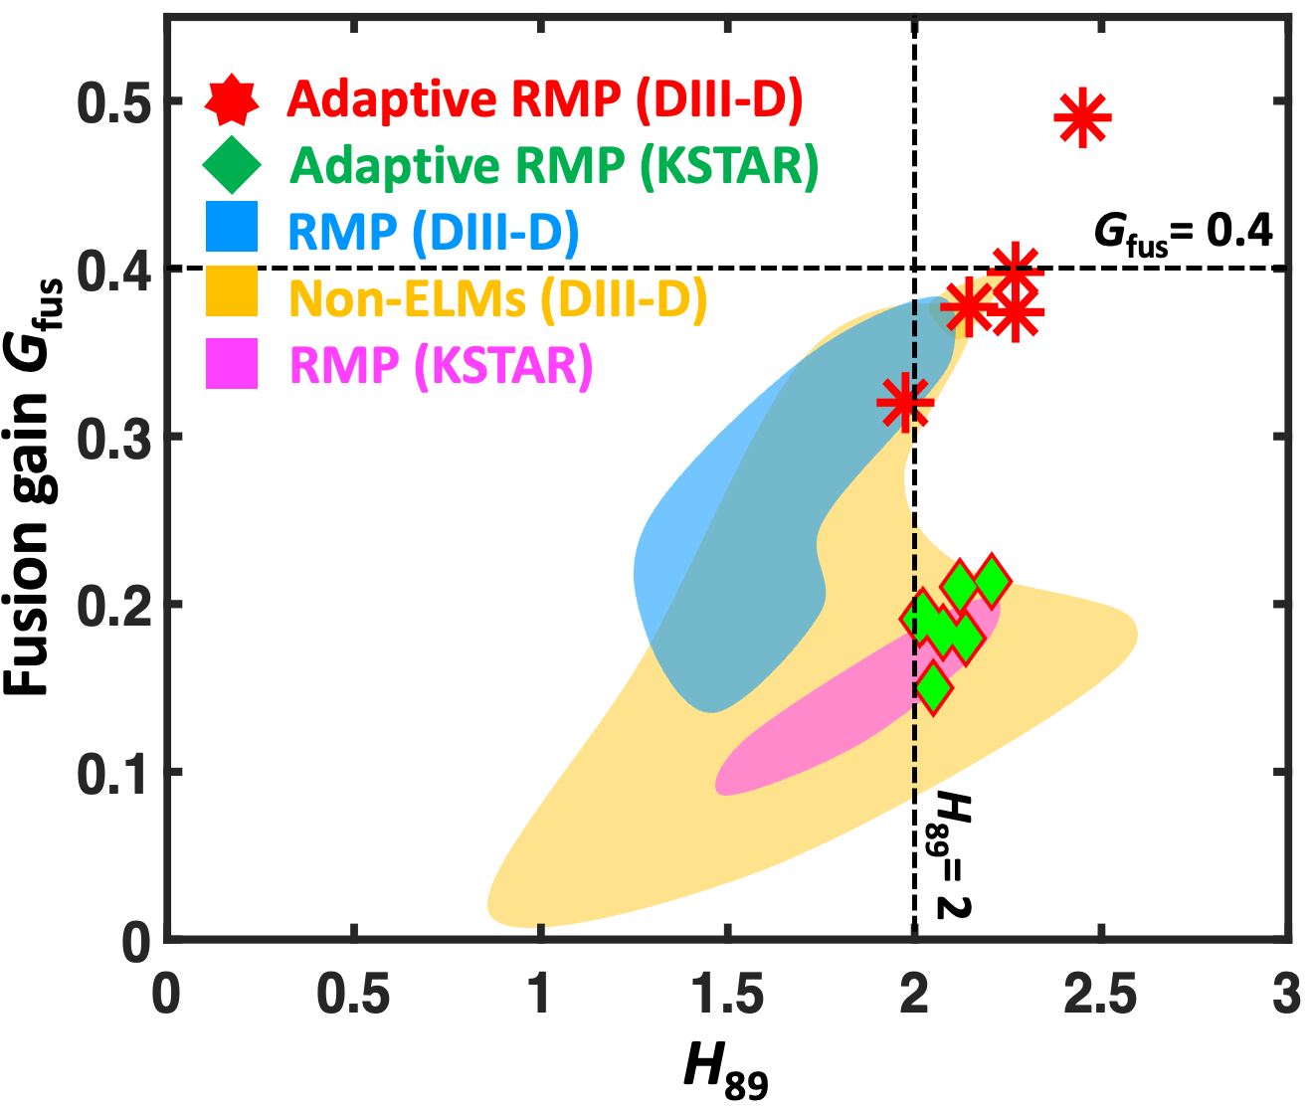
Physics-informed AI-based adaptive 3D control is key to achieve highest fusion performance without harmful edge energy burst
Conventional 3D-field has empirically optimized waveform (Coil configuration) → Non-ITER applicable.
ML-surrogate model to the Physics Model (GPEC-NET) for automatic coil configurations.
Automated & adaptive ELM control in KSTAR without human decision.
Highest fusion performance achieved in two devices. Also, longest discharge at KSTAR.
Kim et al 2024 Nat Commun 15, 3990

Slide 8
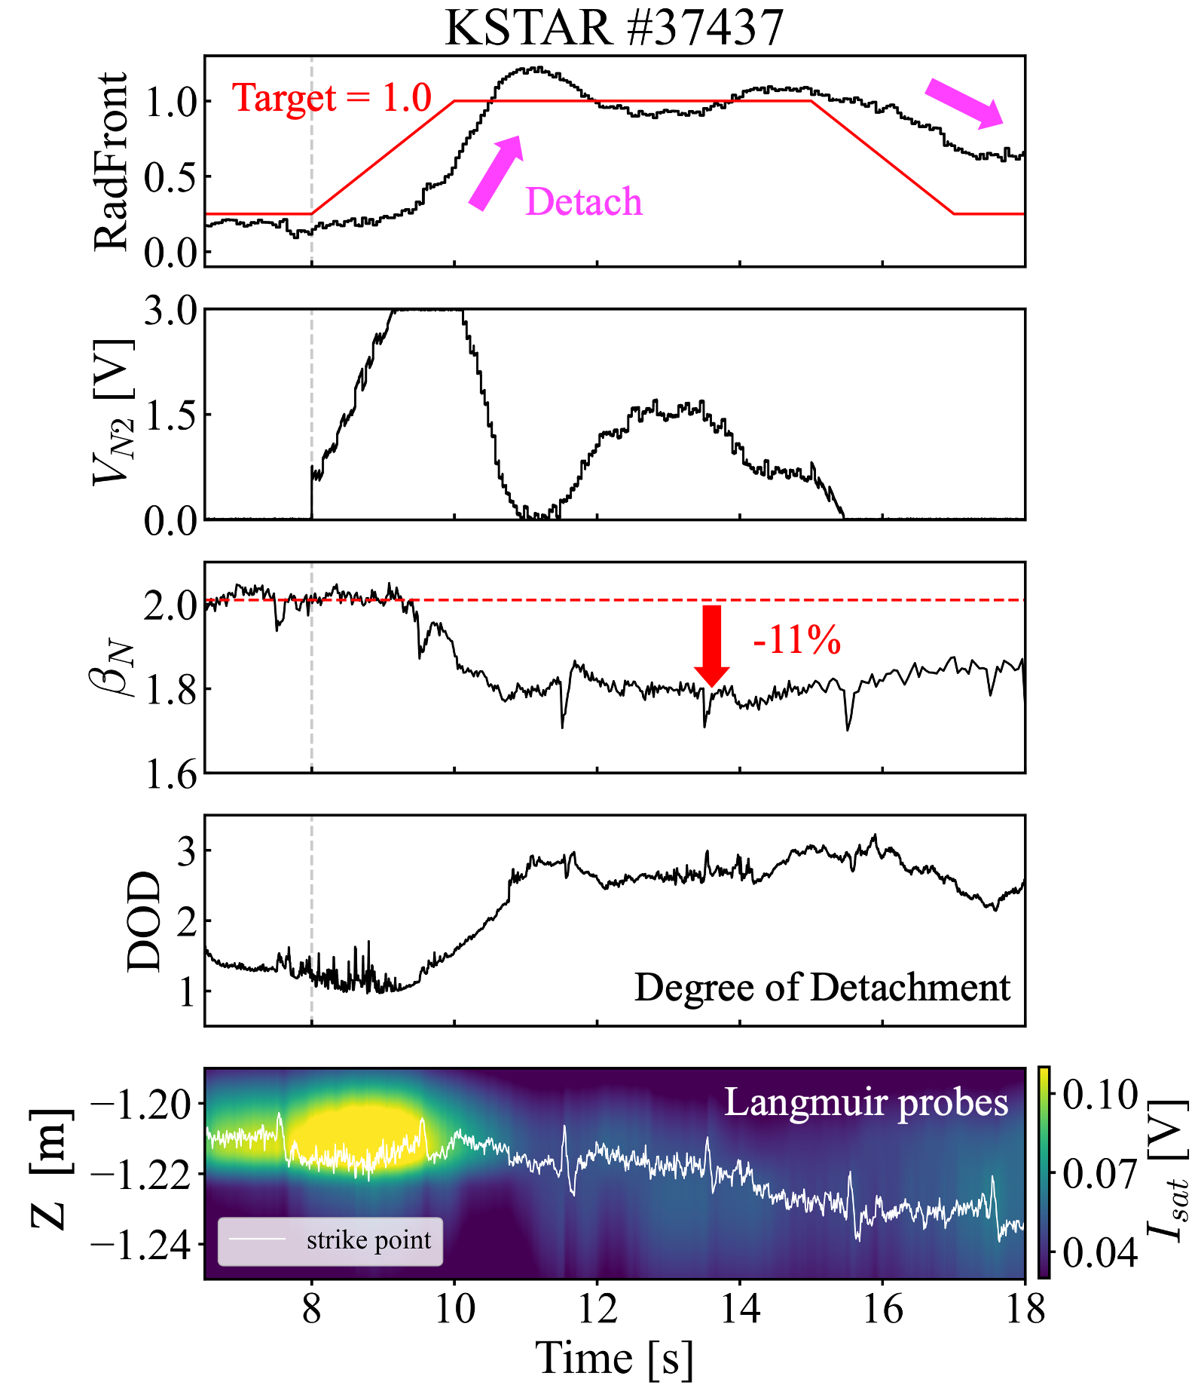
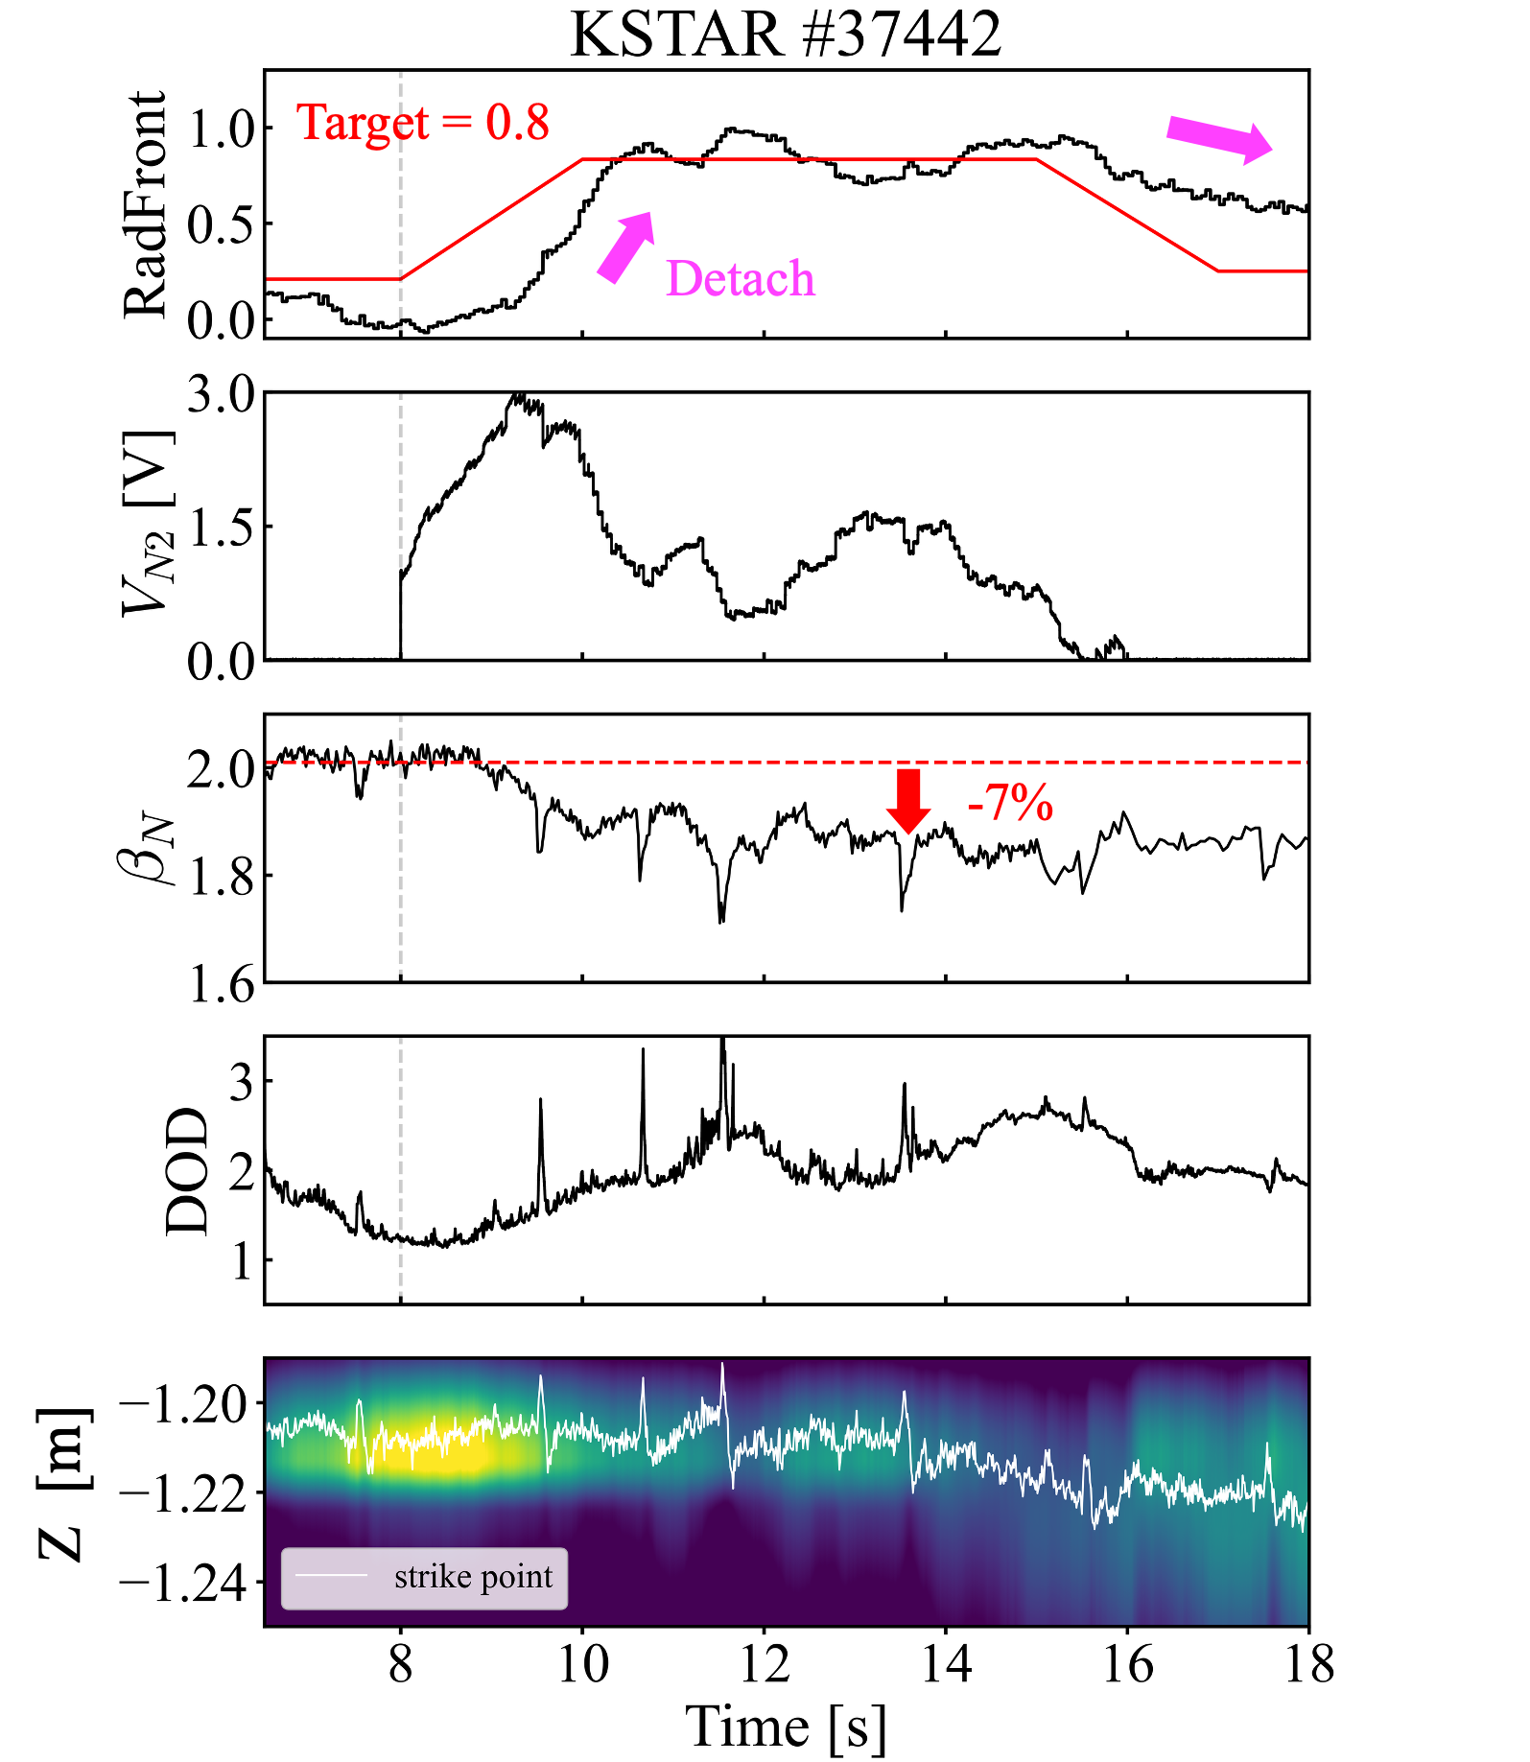
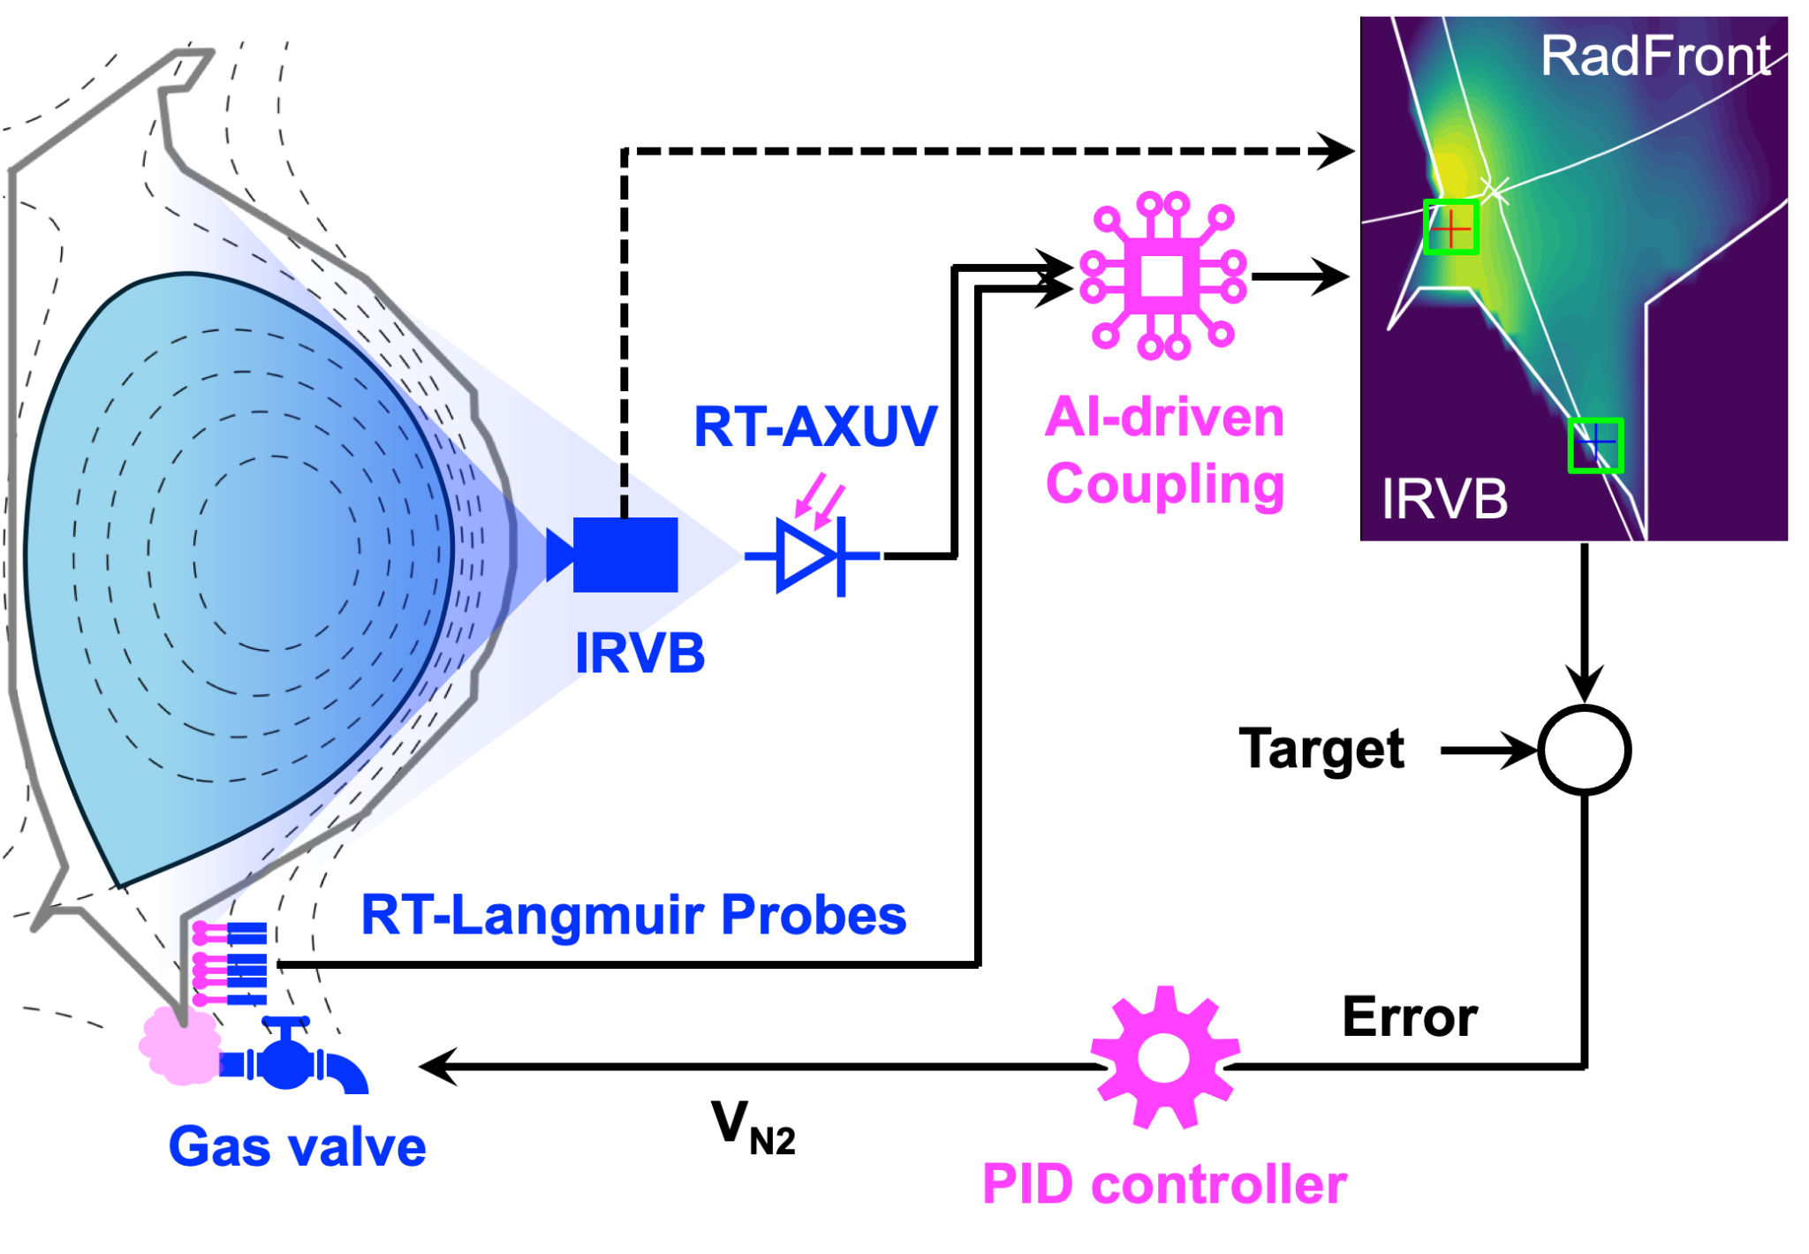
Detachment control at KSTAR
An AI-based diagnostic failure mitigation
We designed a detachment controller using InfraRed Visible Bolometer (IRVB) as the main diagnostic to track the radiation front.
But IRVB broke only a few days before the experiment.
We used the Diag2Diag approach to generate the same input to the controller from AXUV and Langmuir Probe as we could have with IRVB.
As a result, we demonstrated AI-driven detachment control with varying target detachment level
First successful attempt AI-driven diagnostic coupling in KSTAR detachment control
𝛽_{N} degradation reduced from 11% to 7% in lower target detachment level → can tune trade-off!

Slide 9
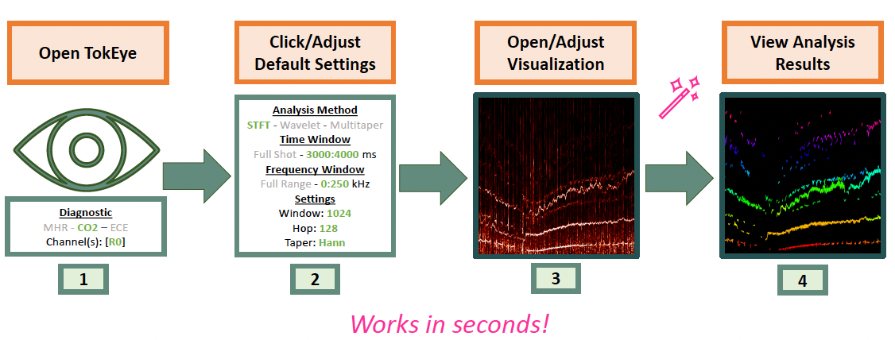
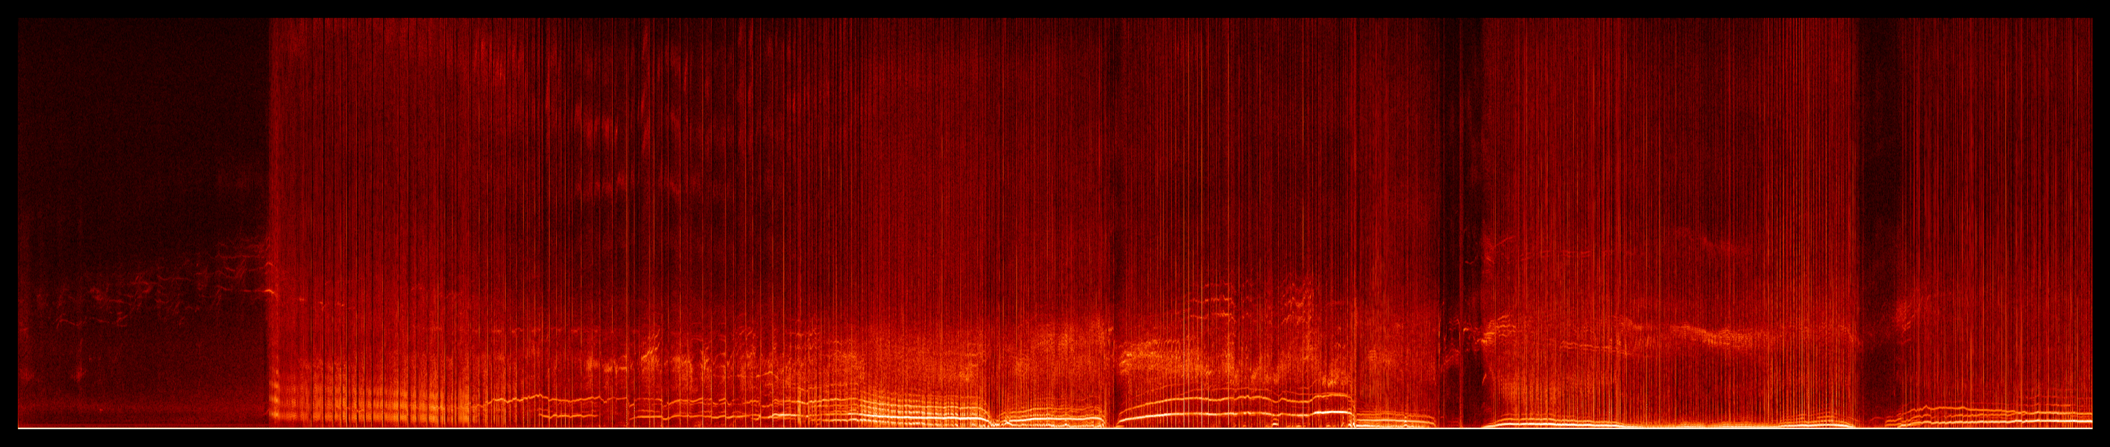
TokEye: Automating Diagnostic Analysis for Fusion
The Challenge: Almost all analysis in fusion is diagnostic-specific, needing extensive tuning to extract useful info. This makes automated signal extraction for both scientists and AI labelling very challenging.
The Vision: During experiments and between, we want a fast way to process and keep track of all diagnostics.
Solution: An automated enhancement and labeling tool for fusion multi-diagnostics analysis. Supports many diagnostics not limited to CO2, ECE, Magnetics, BES…
Automatic enhancement and pattern detection on DIII-D data
Time →

Slide 10
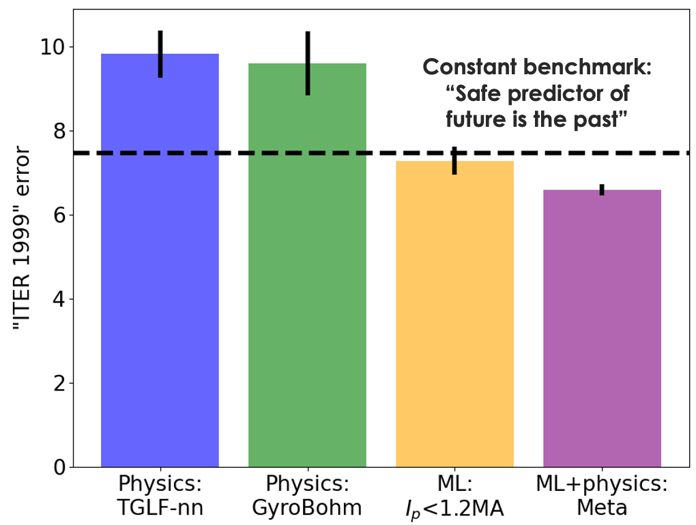
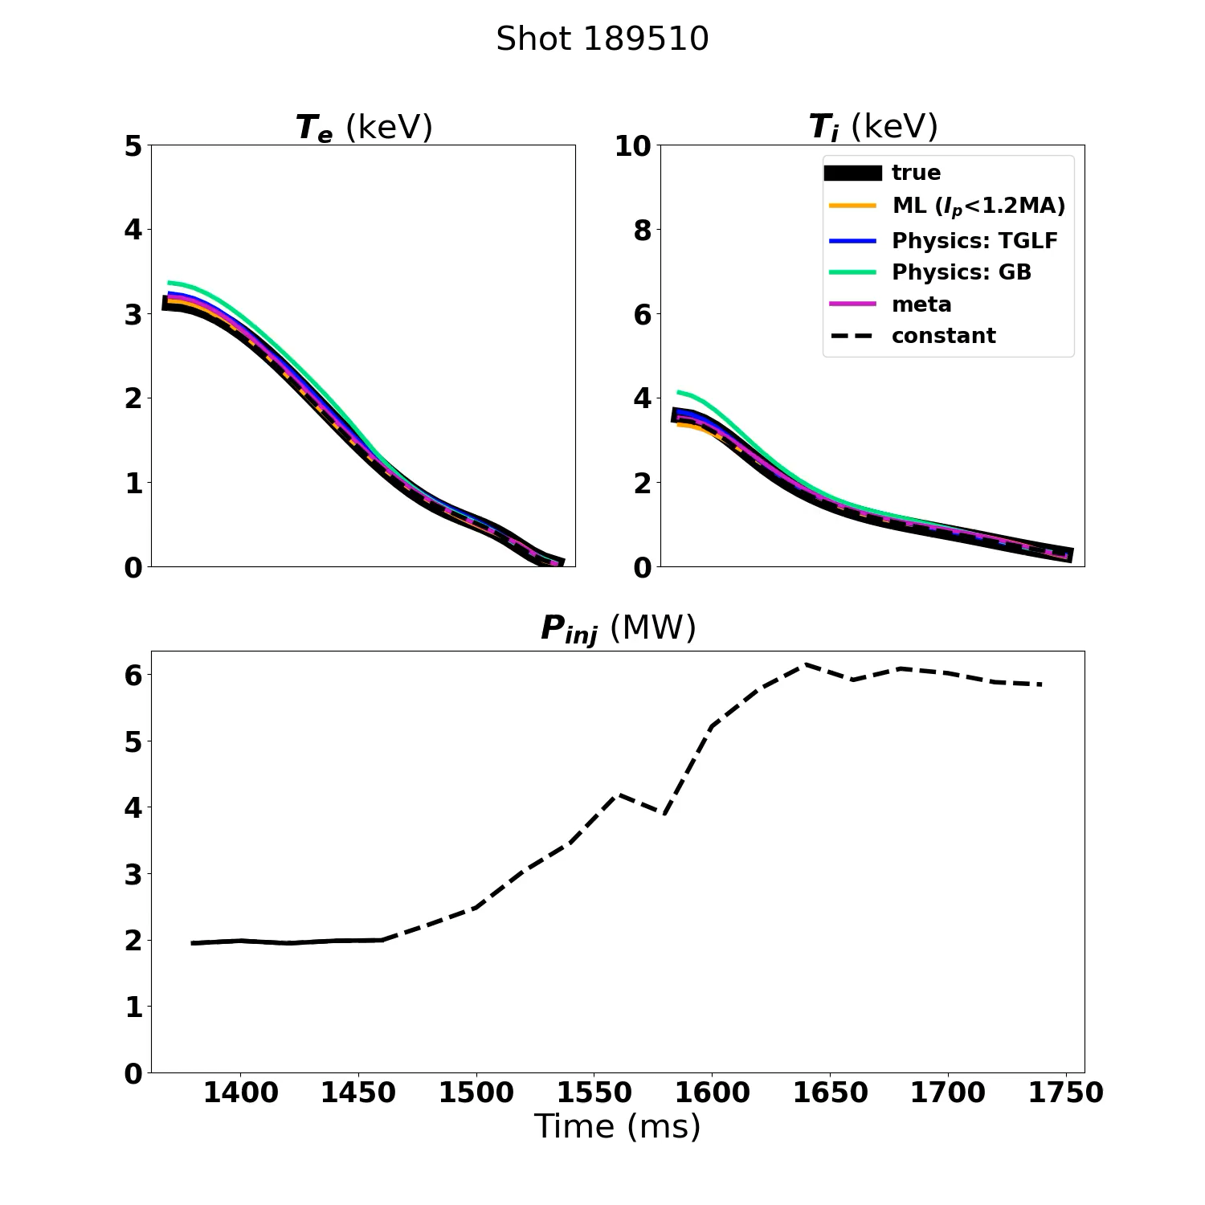
Generalizable predictors to guide ITER operation:
Combining physics-based + data-driven models
ITER operation: use all information until now to predict (plan) next shot
Data from previous shots
Physics-based simulations
All Physics-based simulators (TGLF, GyroBohm) and ML-based models fail to extrapolate the profile prediction
Meta-learner, combining ML-model and physics-based prediction, extrapolates better than any individual predictor!
Abbate et al 2025 Nucl. Fusion 65 056014

Slide 11
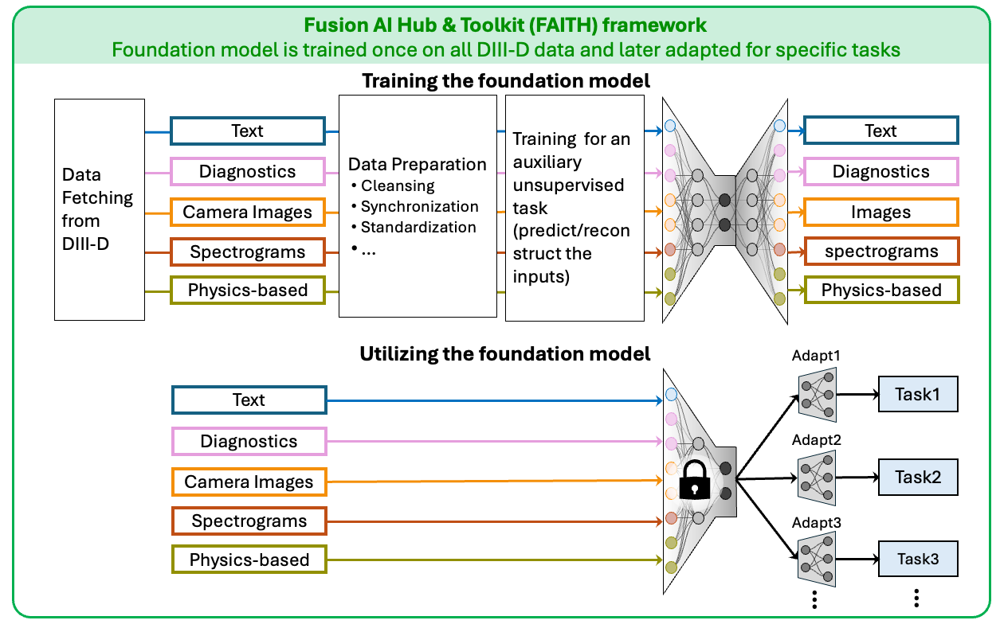
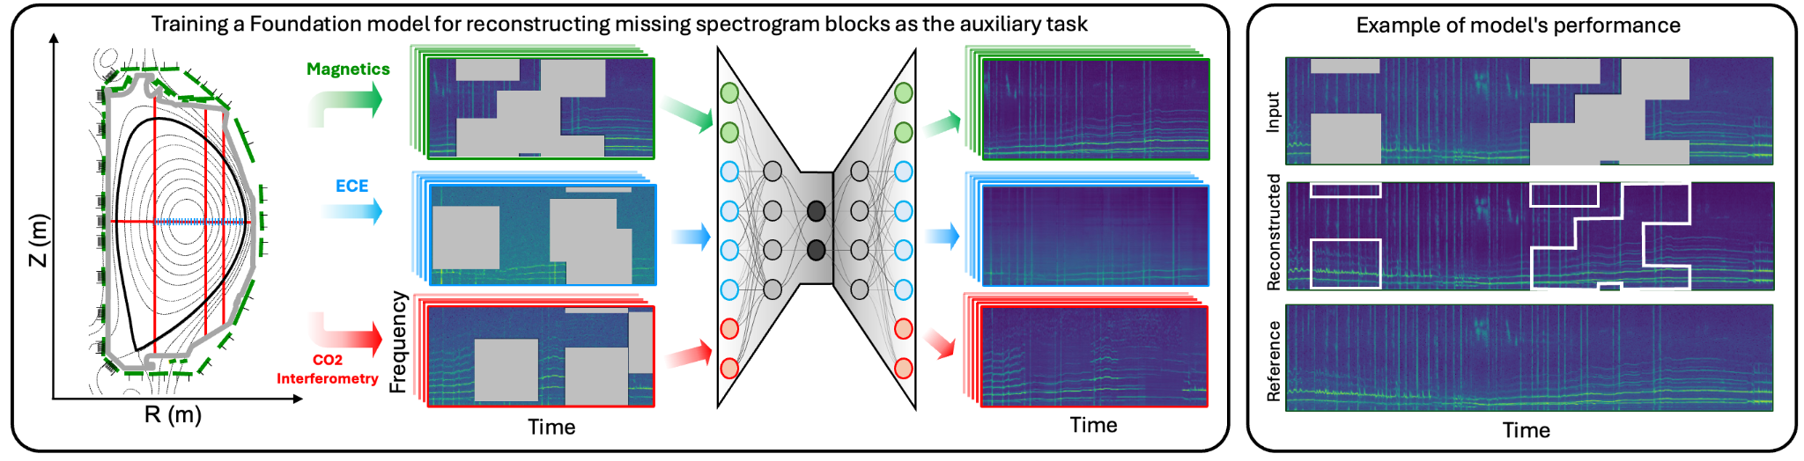
FAITH:
Fusion Artificial Intelligence Toolkit & Hub
Foundation model is trained on all the available data for an auxiliary unsupervised task (e.g. reconstructing masked data).
Foundation models learns a general understanding of plasma behavior.
It can then be adapted for specific task with a limited available data for that task.
FAITH is a github repo designed for the whole foundation model training pipeline.
Example of training a foundation model to reconstruct masked spectrograms

Slide 12
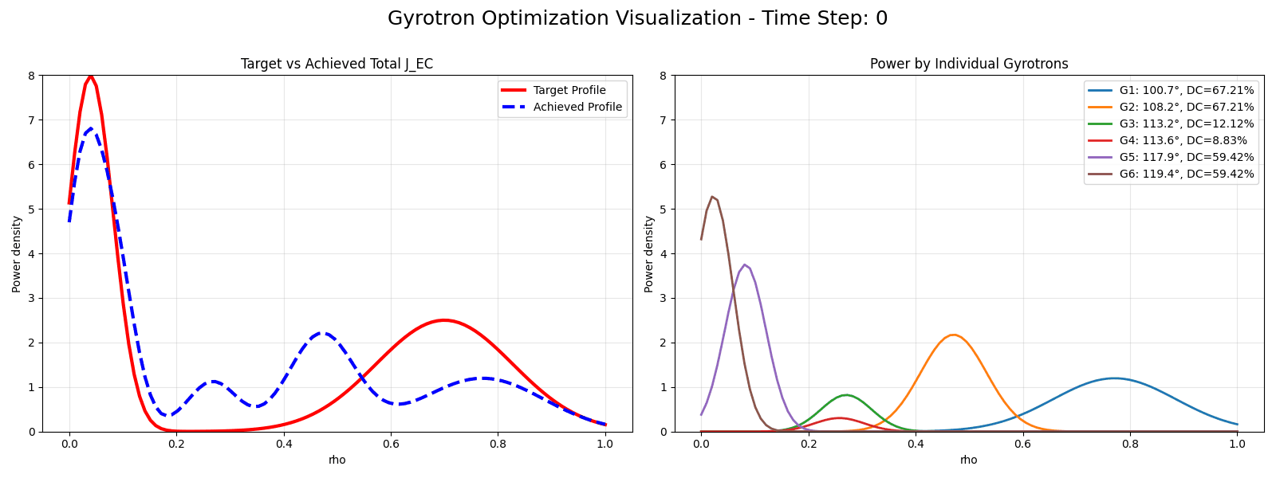
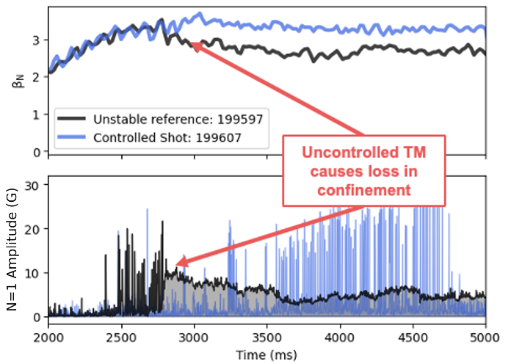
Coordinating Gyrotrons for Advanced ECH Control
Real-time ECH optimizer dynamically tracks target
ECH is a highly relevant heating actuator for low B_{T} FPPs
At present in DIII-D, ECH is primarily used feedforward
Preset power waveforms with little-to-no modulation
–Fixed angles
ML surrogate enables advanced controller
Torbeam ML surrogate model runs real-time to calculate ECH/ECCD deposition profiles
Genetic optimizer finds good angles and duty cycles to achieve requested ECH profile
AI-based ECH control at DIII-D in shots 199597 (without control) and 199607 (with control), achieving improved plasma performance and tearing mode stability.

Slide 13
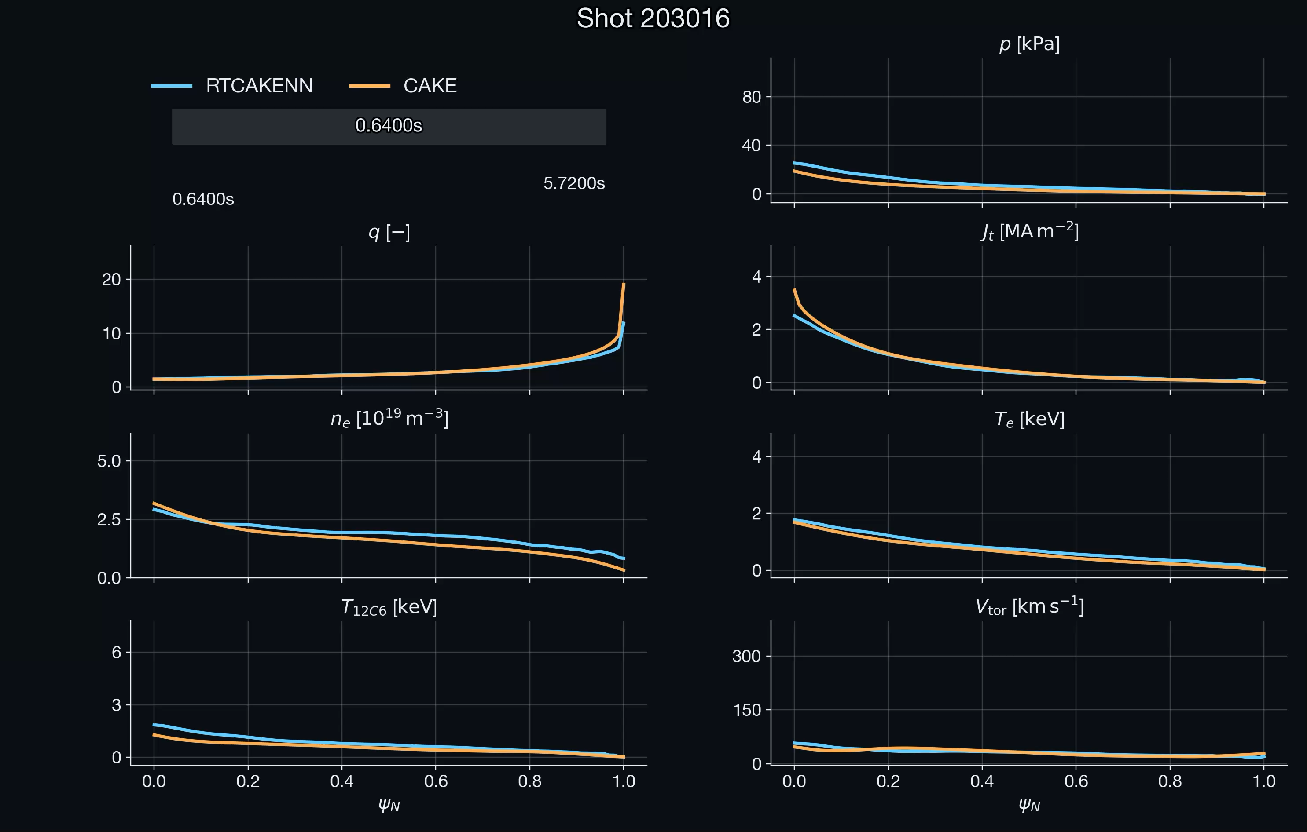
RTCAKENN: Predict kinetic profiles in real-time with offline quality under severe conditions
CAKE: Consistent Automatic Kinetic Equilibrium reconstruction*
RTCAKENN: Real-time CAKE Neural Network surrogate model**
Even during diagnostic failures, e.g., when TS measurements and MSE are unavailable for several time slices, RTCAKENN can still provide profile reconstructions with accuracy approaching that of offline CAKE.
* Xing et al, 2021 Fusion Eng. & Design 163 112163
** Shousha et al 2024 Nucl. Fusion 64 026006

